Slide 1
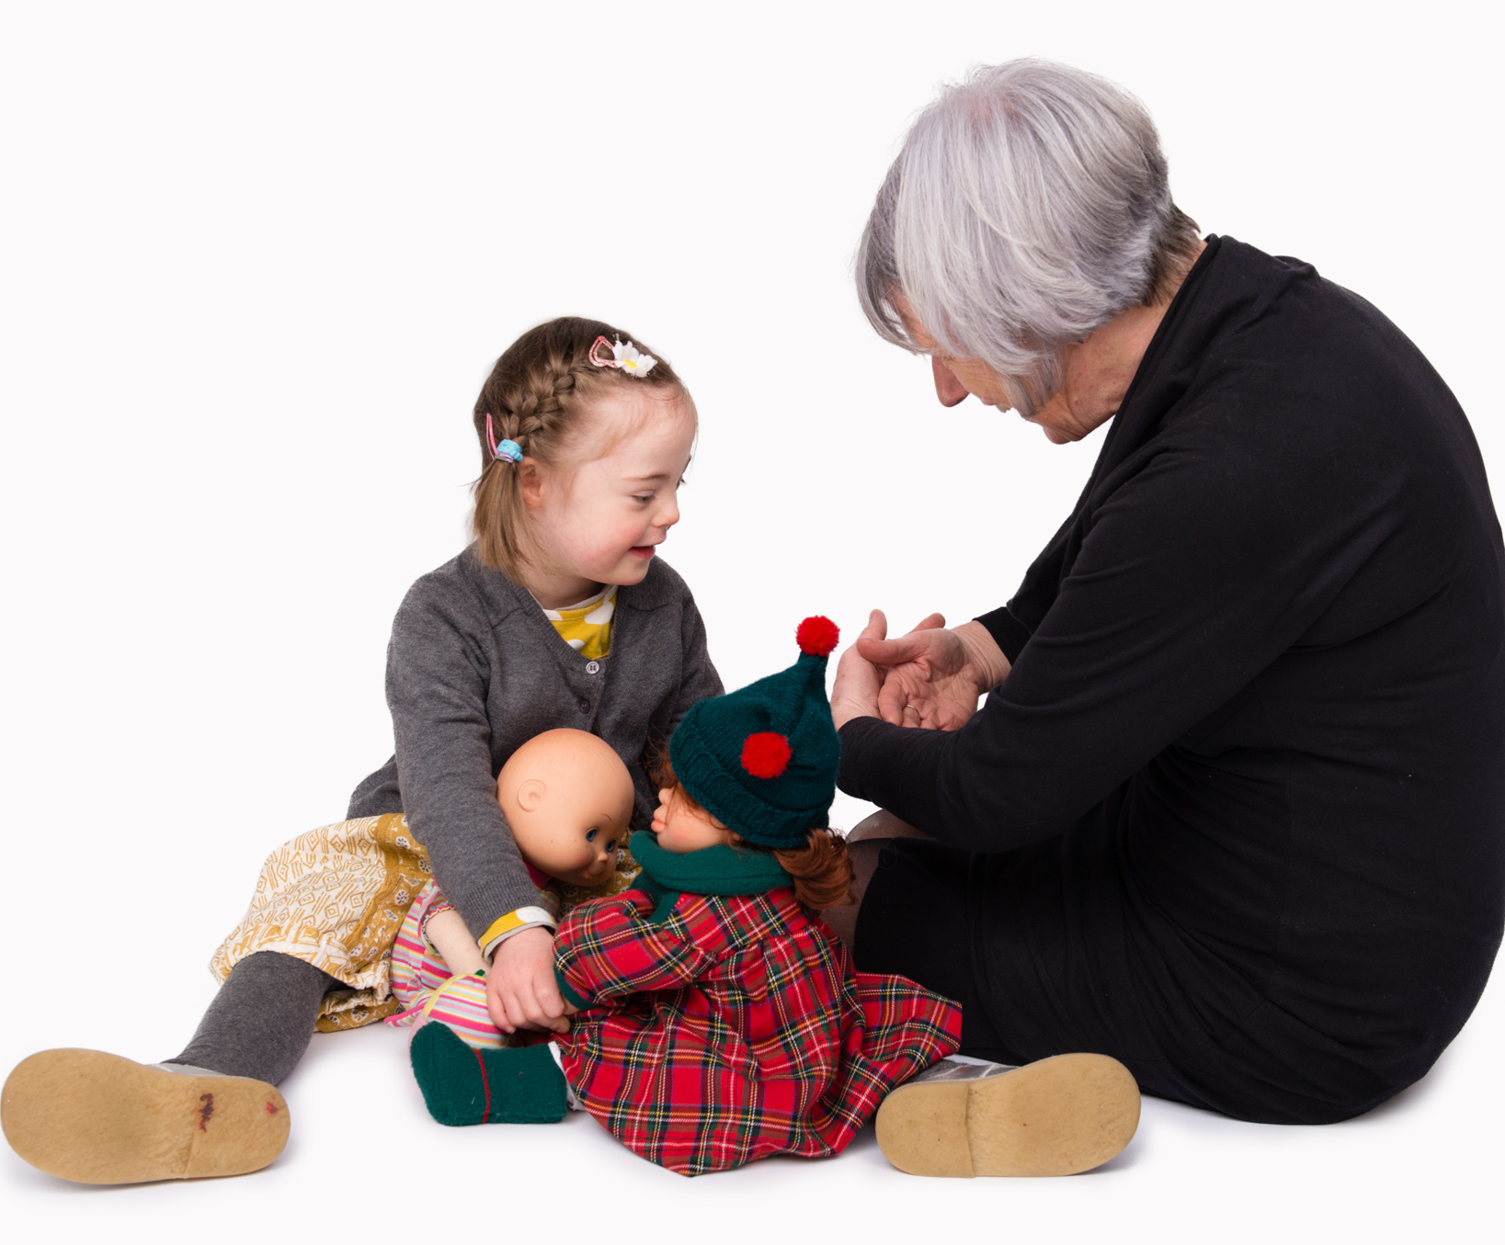
Transitioning from early years to primary school education
Nicola Hart

Slide 2

Worries
Will my child get the support they need?
Will my child’s needs be understood?
Will my child learn?
Notes:
parent talk to children boosts their language development, and accordingly, if a child has poor language skills, this is likely to be caused by inadequate talk from parents.
BUT Poor language in the child leads to less talk from the parent. This could occur if, for instance, parents are discouraged from talking to a child who is unresponsive and appears not to understand.

Slide 3
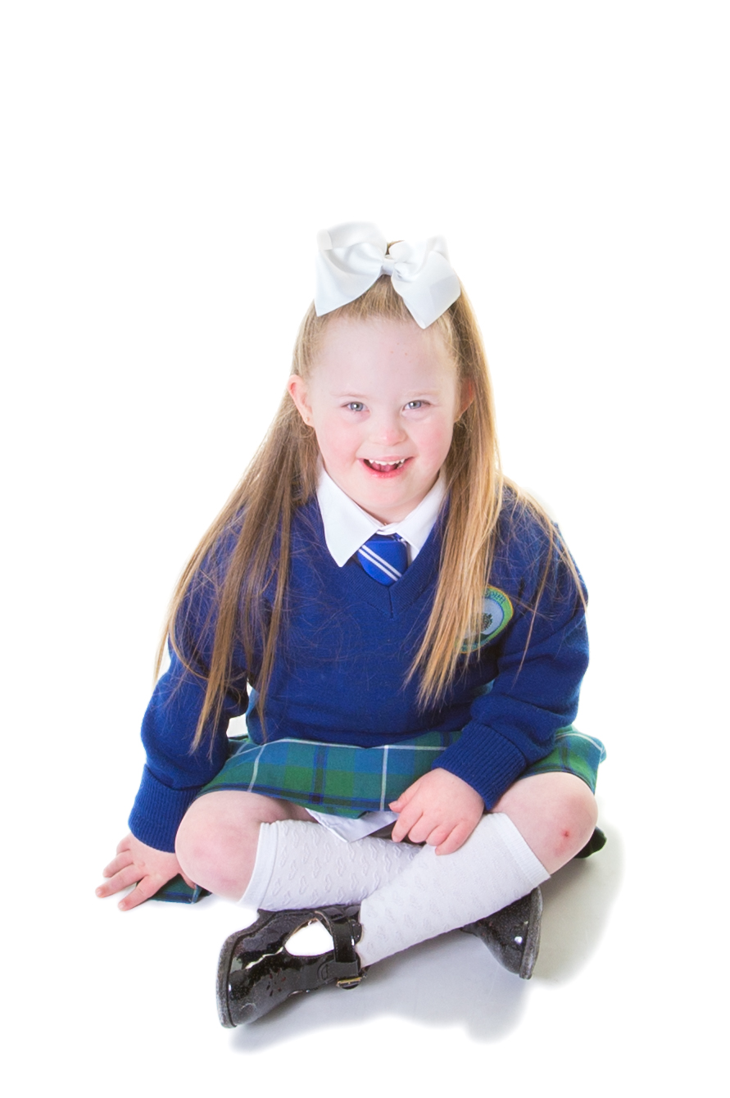
Topics
Down syndrome
Language and communication development
Vision and hearing
Role of the SNA
Learning support
Literacy and numeracy
Notes:
parent talk to children boosts their language development, and accordingly, if a child has poor language skills, this is likely to be caused by inadequate talk from parents.
BUT Poor language in the child leads to less talk from the parent. This could occur if, for instance, parents are discouraged from talking to a child who is unresponsive and appears not to understand.

Slide 4

Down Syndrome
Basic information:
Down syndrome is a chromosomal anomaly. People who have Down syndrome have an extra copy of chromosome 21.
This is a genetic difference that happens in the very early stages of embryonic development.
It affects all parts of the body.
It is not a disease.
Down syndrome occurs in around 1 out of every 444 births in Ireland.

Slide 5
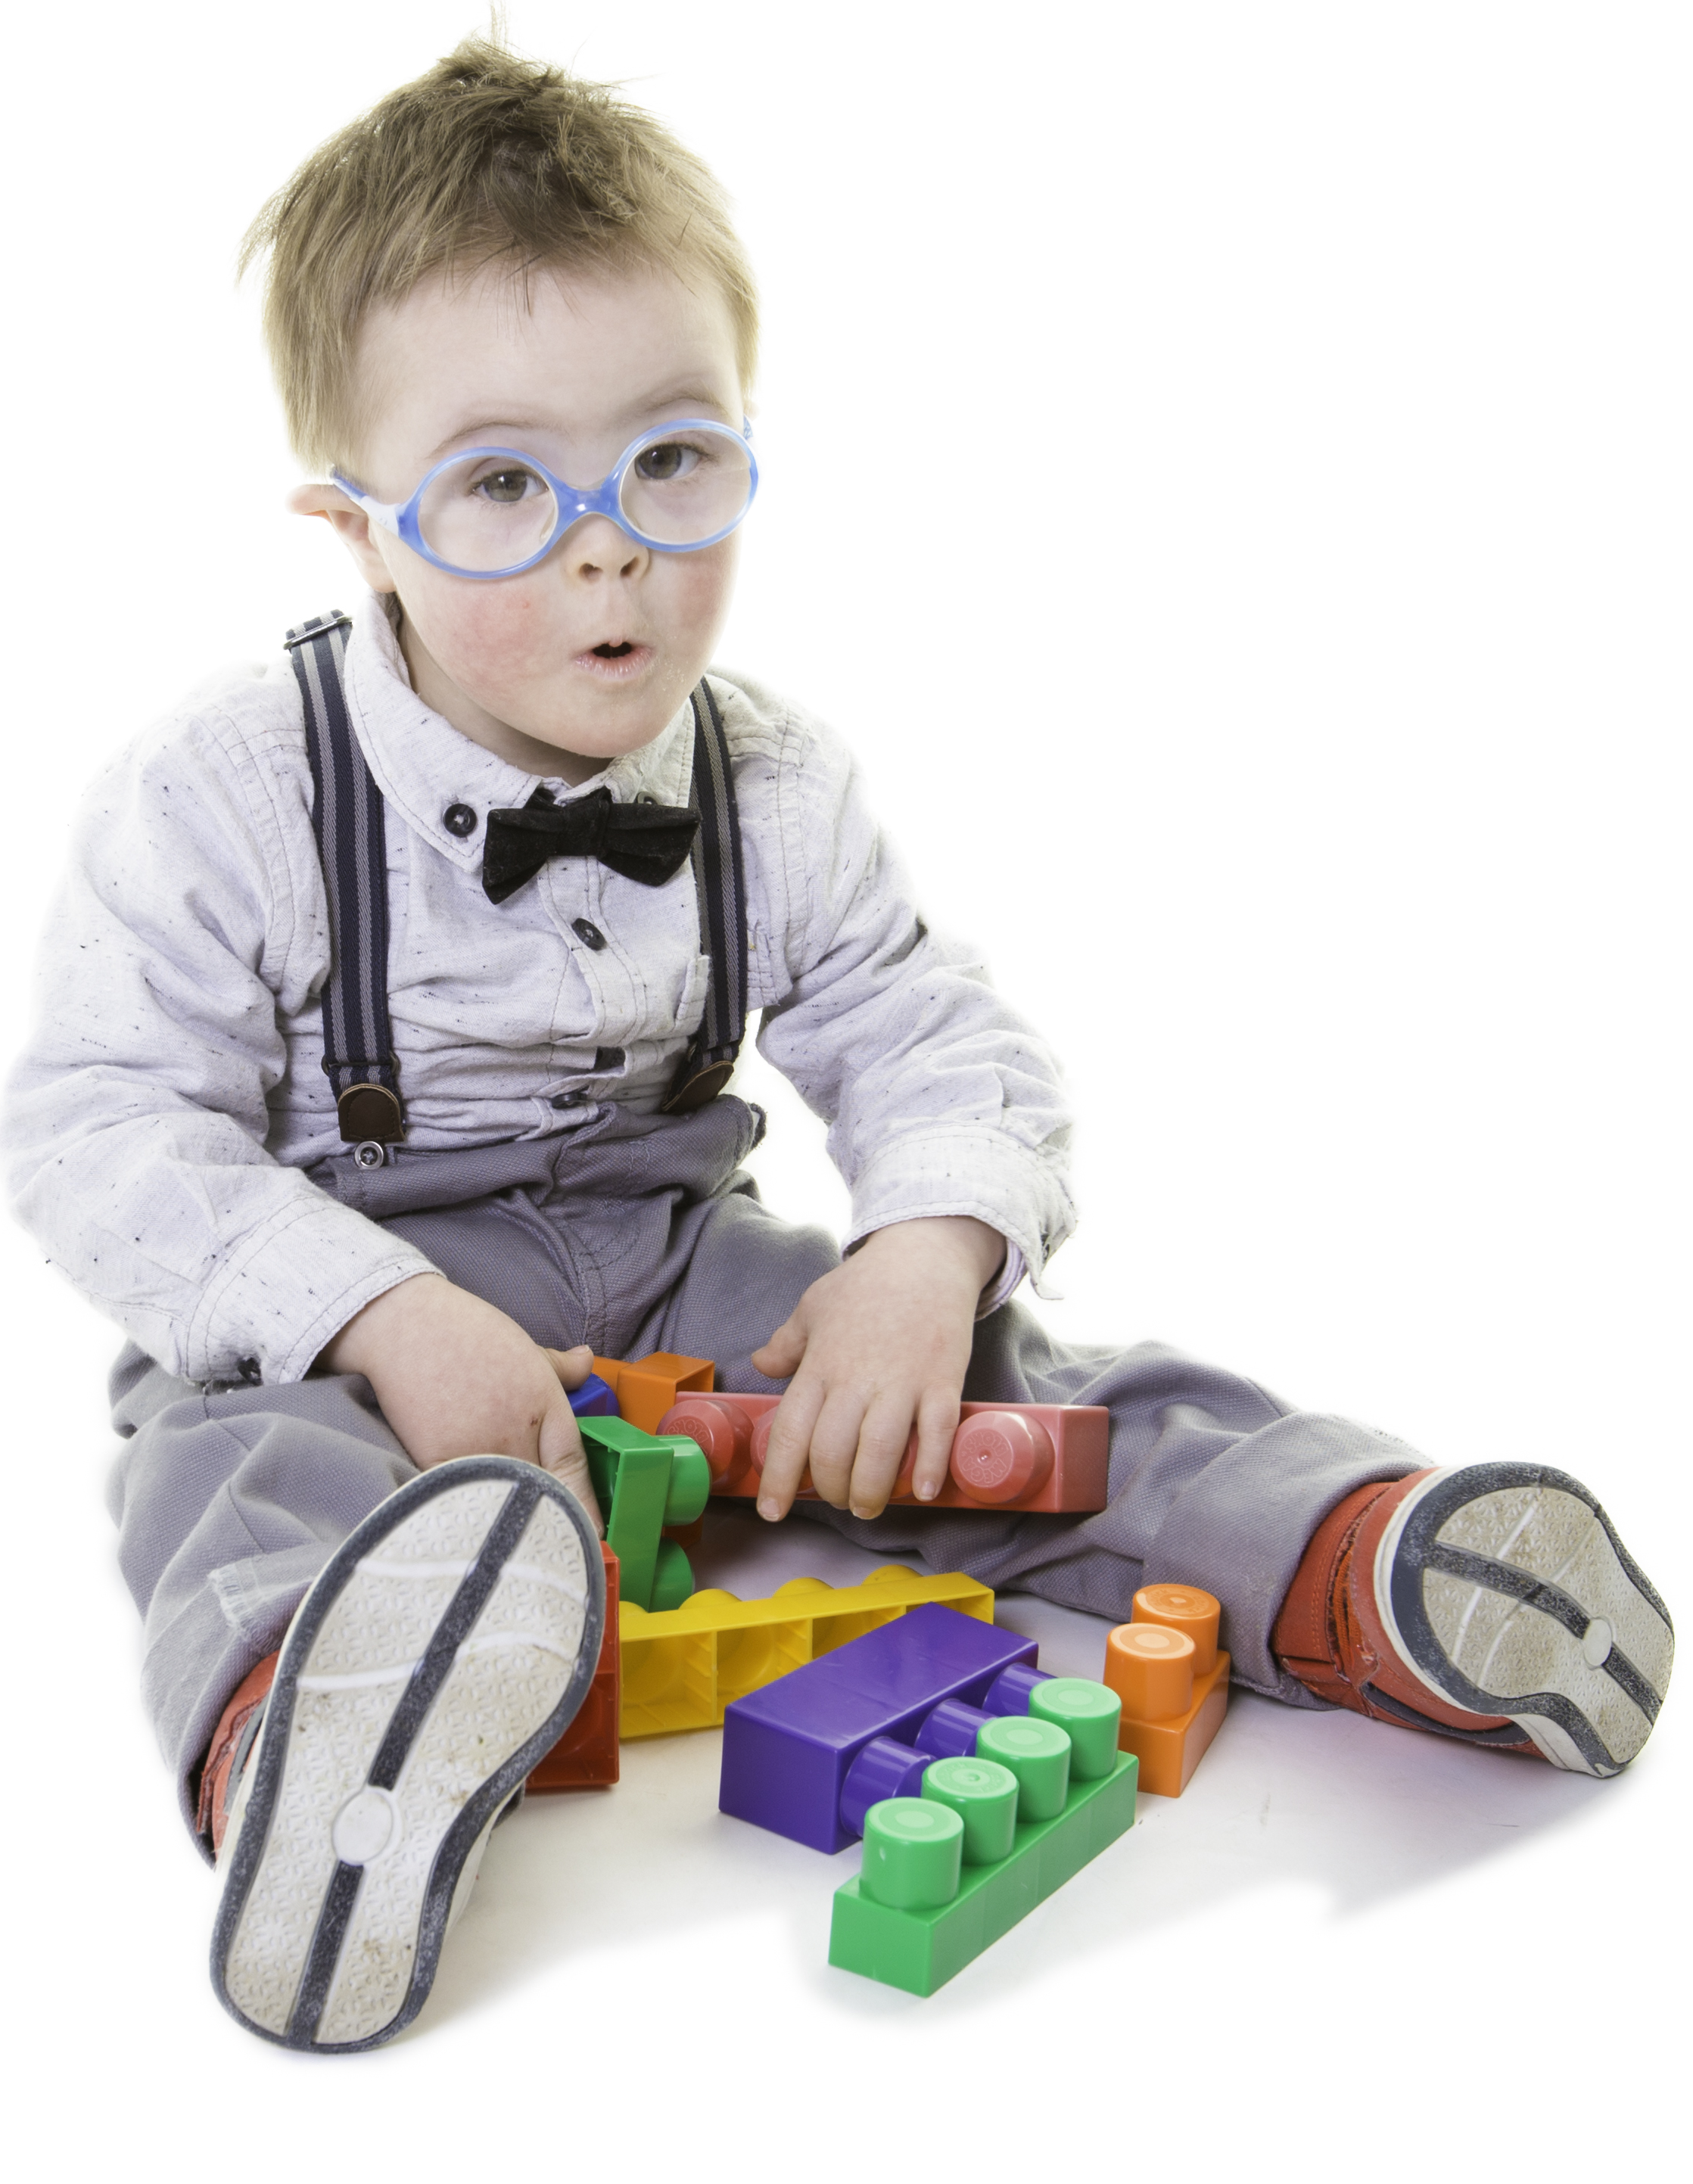
Language development
Children learn by listening (if people talk to children, they will learn language)
Children learn through exploring (if they explore their environment with a responsive adult who adds language, they will listen and learn)
Children learn by doing (when children attempt communication, adults respond, adding information)
Notes:
parent talk to children boosts their language development, and accordingly, if a child has poor language skills, this is likely to be caused by inadequate talk from parents.
BUT Poor language in the child leads to less talk from the parent. This could occur if, for instance, parents are discouraged from talking to a child who is unresponsive and appears not to understand.

Slide 6
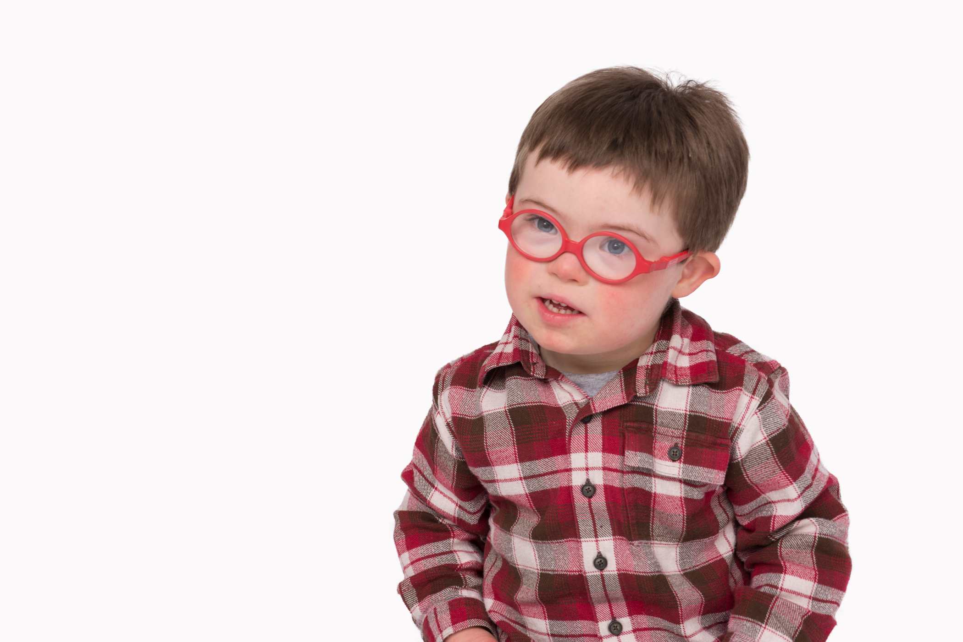
Language development
Over 80% of children with Down syndrome have difficulty hearing, so may not respond. We often talk less to children who are less responsive, and give them fewer choices.
Motor skills are slower to develop, so there’s less exploration.
Visual difficulties may mean it’s hard to see what people are talking about.
Most children with Down syndrome need extra time to process and make sense of language.
Explicit, visual language teaching is needed

Slide 7
Areas to consider
Overall communication
Vocabulary
Linking words: sentences and grammar
Speech

Slide 8
Likely Issues
Hearing loss
Auditory discrimination
Auditory memory
Vision issues
Medical issues
Opportunity

Slide 9
Communication
Age | Communication | Vocabulary | Grammar | Speech
2-5 years | Initiating joint attention using words, sounds, pointing, signs and gestures. Requesting. Trying again when misunderstood (repair)
5-7 years | Linking words and ideas, communicating in short phrases maybe just using key words. Learning to sequence ideas together into short stories. Lots of opportunities to communicate. Routines. Turn-taking. Open questions. Retelling favourite stories

Slide 10
Vocabulary
Age | Communication | Vocabulary | Grammar | Speech
2-5 years |  | Average vocabulary at 3: 170 words, but range 20-411. Understanding is better than production.
5-7 years |  | Vocabulary learning accelerates. Average 300-400 words Explicit visual teaching needed Core vocabulary of first 700-800 words is well studied. Needs to be targeted and taught. Pre-teach words and concepts ahead of topics.

Slide 11
Grammar
Age | Communication | Vocabulary | Grammar | Speech
2-5 years |  |  | 50-100 words, start to link words together. 250-300 words, beginning of grammar.
5-7 years |  |  | As vocabulary develops, 2-3 word phrases emerge. Often ‘telegraphic’ Short correct sentences increase. Teach grammar through recasting, reading, and explicit instruction.

Slide 12
Speech
Age | Communication | Vocabulary | Grammar | Speech
2-5 years |  |  |  | Speech very variable. Often difficult to understand for unfamiliar listeners.
5-7 years |  |  |  | Speech still very variable. As sentence length increases, intelligibility and fluency may temporarily reduce. Making sounds is important: encourage copying, sound play, animal noises, singing, reading aloud, talking, asking and answering questions.

Slide 13
Overall speech and Language
Age | Communication | Vocabulary | Grammar | Speech
2-5 years | Initiating joint attention using words, sounds, pointing, signs and gestures. Requesting. Trying again when misunderstood (repair) | Average vocabulary at 3: 170 words, but range 20-411. Understanding is better than production. | 50-100 words, start to link words together. 250-300 words, beginning of grammar. | Speech very variable. Often difficult to understand for unfamiliar listeners.
5-7 years | Linking words and ideas, communicating in short phrases maybe just using key words. Learning to sequence ideas together into short stories. Lots of opportunities to communicate. Routines. Turn-taking. Open questions. Retelling favourite stories | Vocabulary learning accelerates. Average 300-400 words Explicit visual teaching needed Core vocabulary of first 700-800 words is well studied. Needs to be targeted and taught. Pre-teach words and concepts ahead of topics. | As vocabulary develops, 2-3 word phrases emerge. Often ‘telegraphic’ Short correct sentences increase. Teach grammar through recasting, reading, and explicit instruction. | Speech still very variable. As sentence length increases, intelligibility and fluency may temporarily reduce. Making sounds is important: encourage copying, sound play, animal noises, singing, reading aloud, talking, asking and answering questions.

Slide 14
Speech and language are delayed relative to cognitive development (don’t underestimate!)
Non verbal communication skills can be a strength (use sign, gesture and visuals)
Vocabulary can be a strength, but needs to be explicitly taught
Grammar is often difficult, and child may need lots of support to learn
Speech is challenging for many children with Down syndrome, and phonological awareness is a particular challenge

Slide 15

How can you prepare?
Visual issues

Slide 16
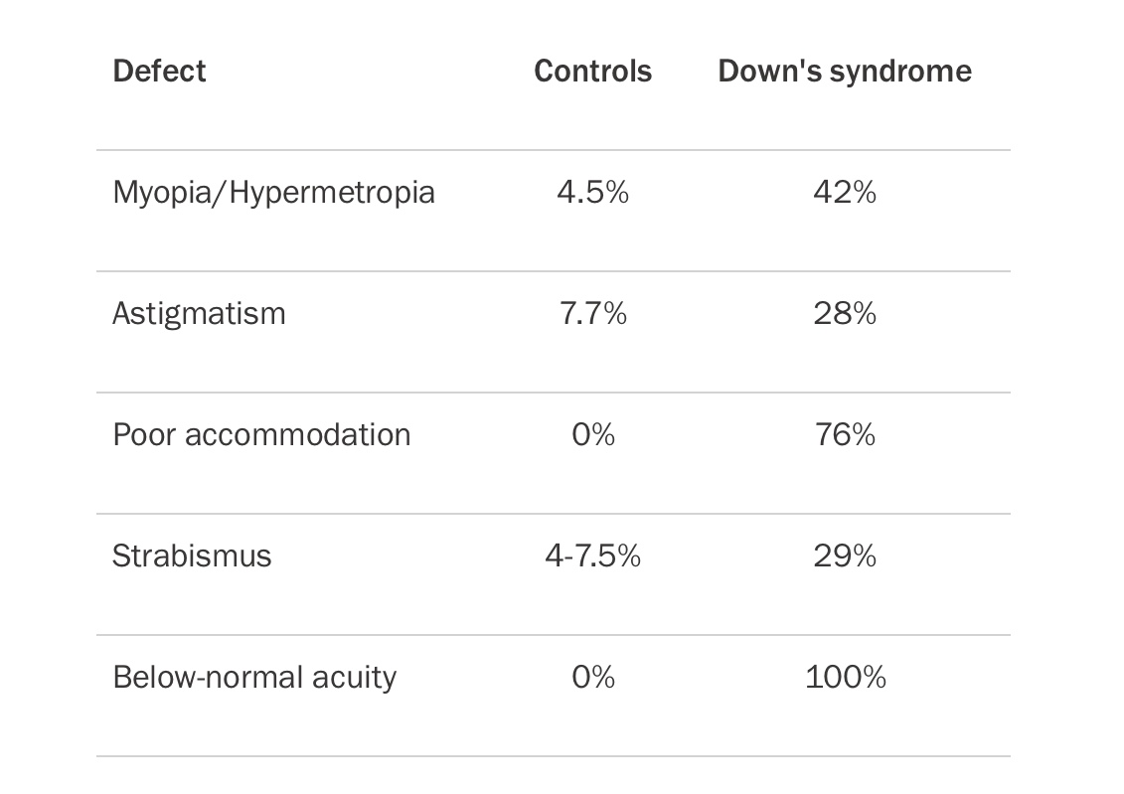

Slide 17
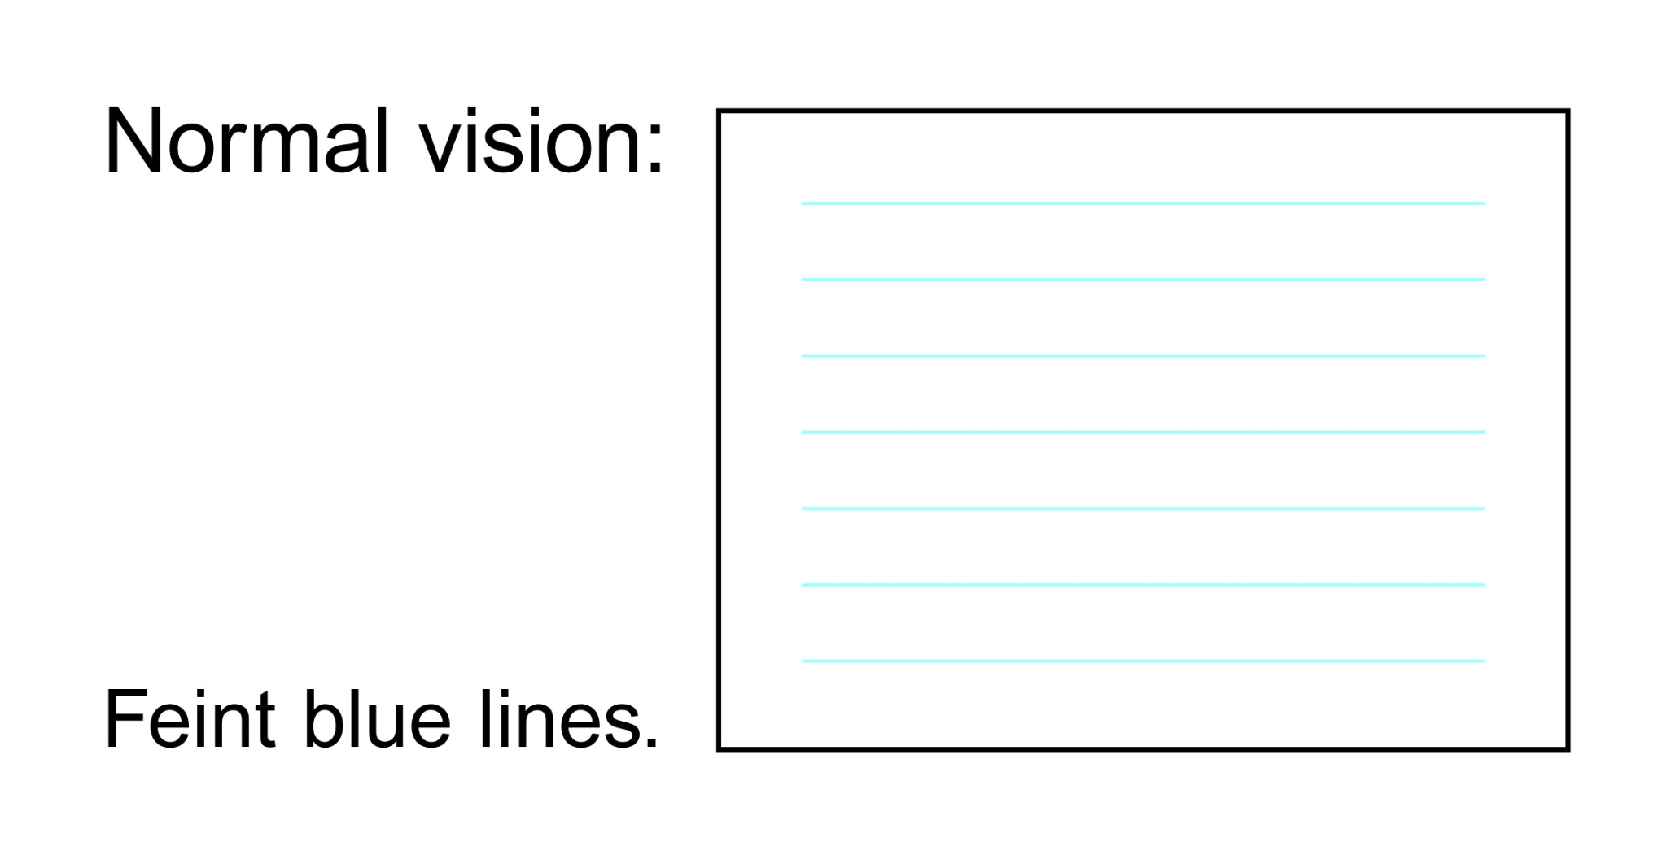

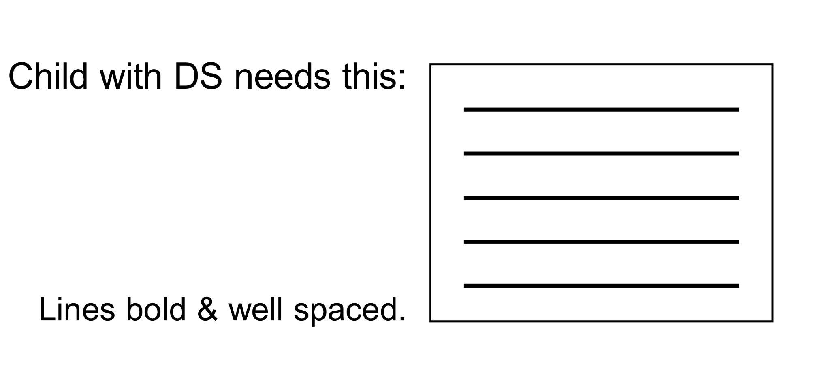
Notes:
This has a big impact when learning to write!

Slide 18
Make sure glasses are worn and clean (and that prescriptions are up to date)
If child is signing, ensure that people are Lámh trained
Label everything!
Make books of key people and places and favourite things
Link visuals to activities and objects (pictures and words)
Use visuals to transition from one activity to the next
Don’t forget to teach visuals

Slide 19
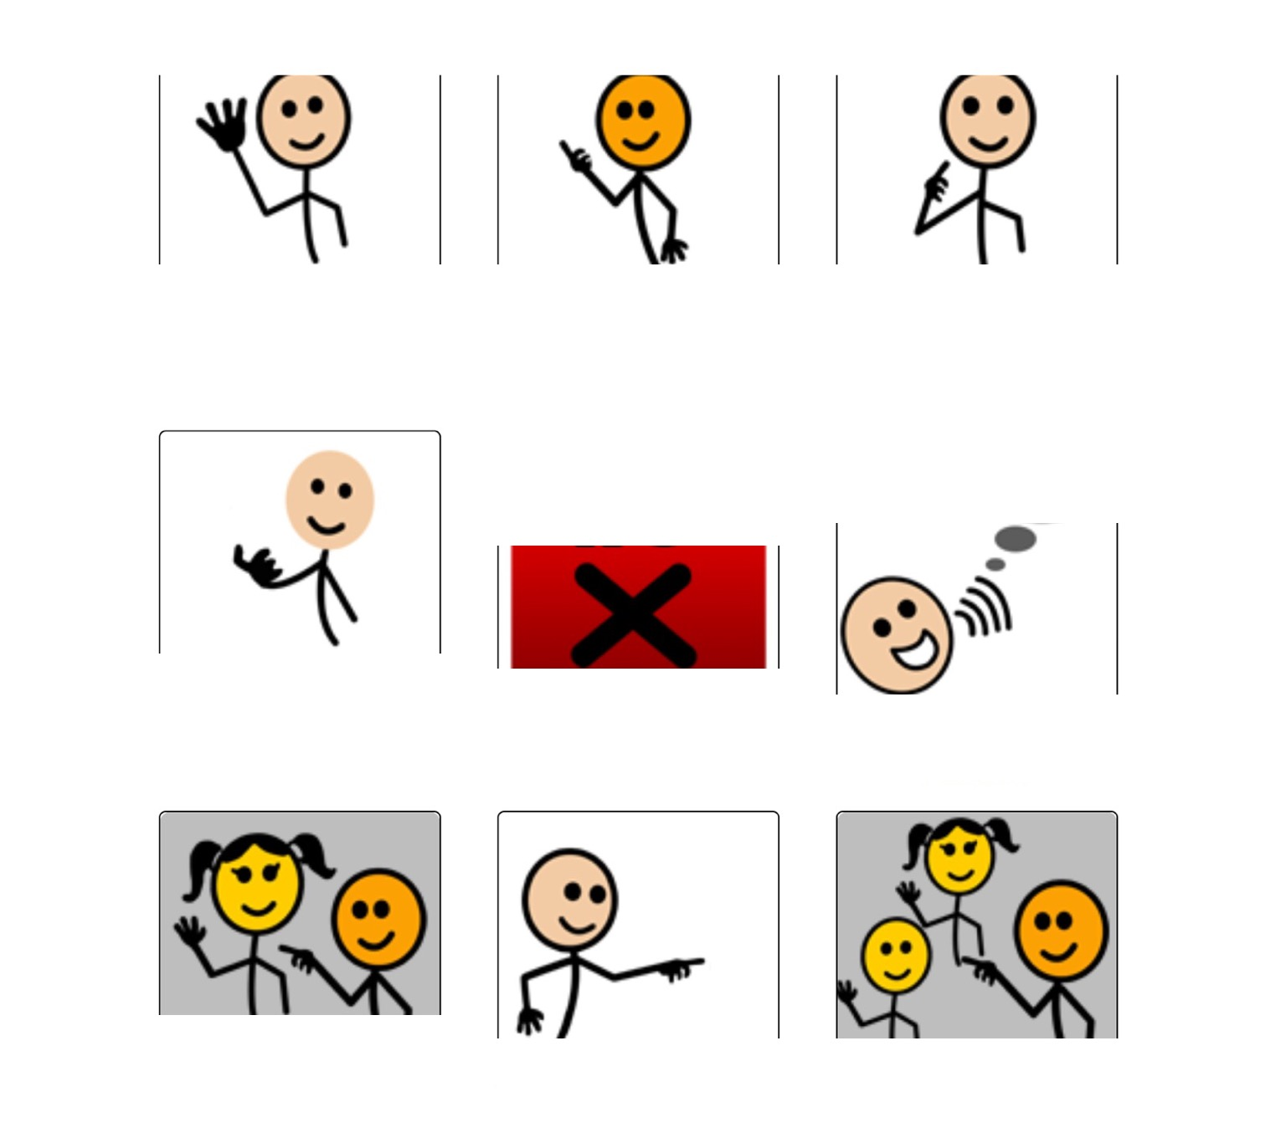
Notes:
This is a typical base board of a fairly simple AAC program.
How many of these can you guess?

Slide 20
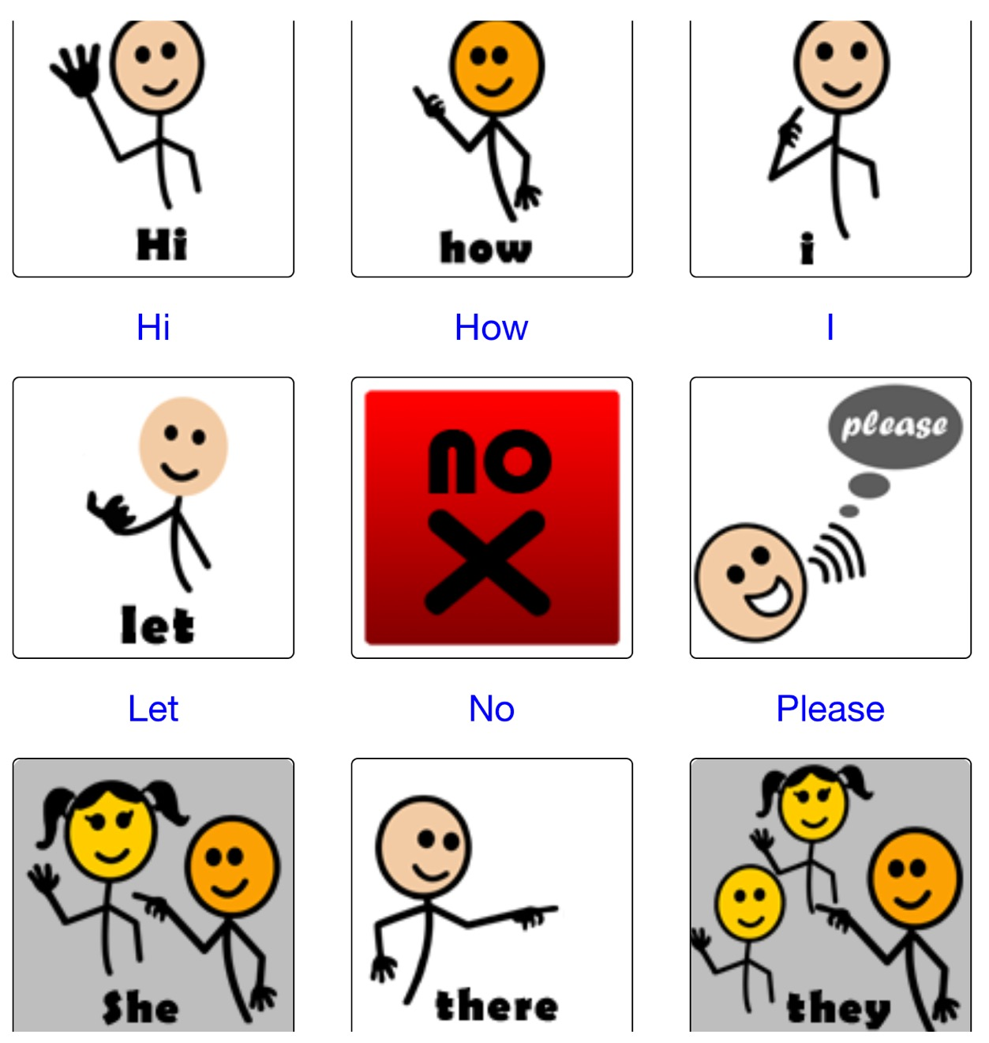
Notes:
When we look at the pictures, because of the words, we tend to underestimate the difficulty.
For children to effectively use, they would need to be taught every symbol.
This really needs dedication.
For many, it might be better to put the time into literacy which is a more flexible alternative.

Slide 21
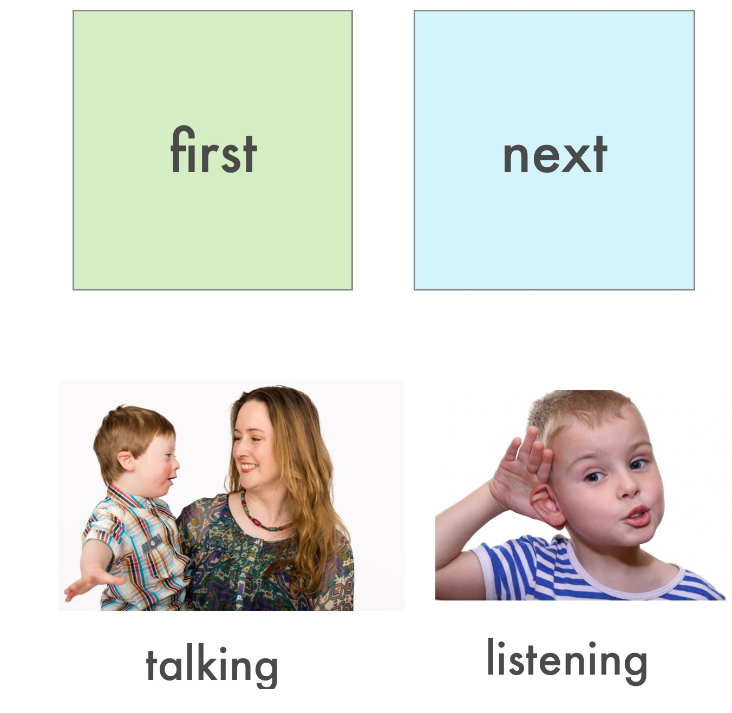
Notes:
Therapy session

Slide 22
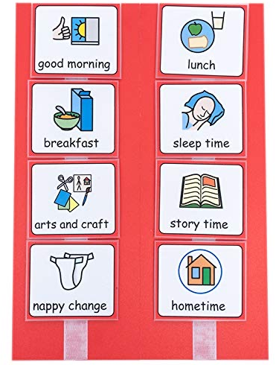
Visual scheduling

Slide 23
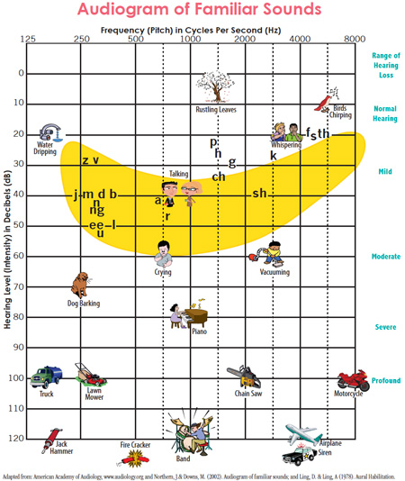
How can you prepare?
Hearing

Slide 24
Hearing
Regular hearing checks and active management
Ensure that hearing aids are worn and working
Reduce background noise
Amplify if needed
Get attention before communicating
Teach new vocabulary with visuals in quiet spaces
Teach written words early

Slide 25
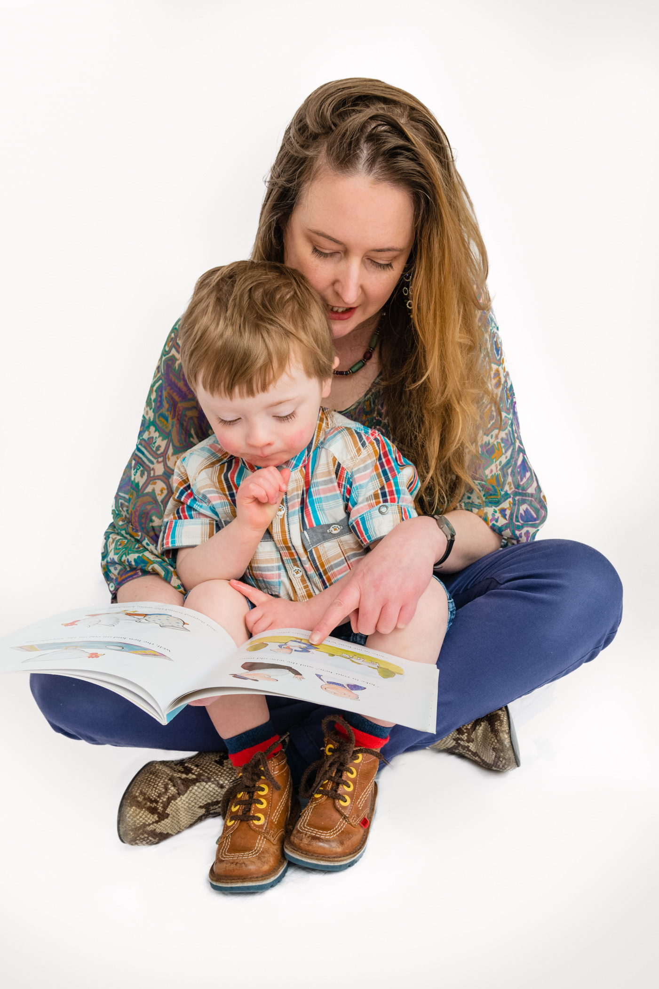
Focus on reading, because:
Visual discrimination is better than auditory discrimination
Early reading seems to have a qualitatively different effect on later language- neuroplasticity
In a population with fluctuating hearing and poor auditory memory, visual input is essential
It is an evidence based method of improving language outcomes
Notes:
Start reading activities when:
receptive vocab of 50-100 words -and says or signs some of them, so ready to combine words.
when child can match and select pictures
teach sight words first (appropriate for receptive vocab)
choose words to make sentences
make books- child's world and interests
play match/select games with same vocab AWAY from pics
Always read words and sentences with child- errorless learning
Ensure message is understood.
Introduce new vocab when child is comfortable and enjoying reading.
Teach phonics when 50-100 sight words

Slide 26
Useful Links
Vision information:
https://youtu.be/HKAv1V_kAvU
https://www.cardiff.ac.uk/downs-syndrome-vision-research-unit/get-advice/for-teachers
DSI emails:
    Nicola@downsyndrome.ie Member Support Team Leader
    Claire@downsyndrome.ie Early Years Specialist
    Fidelma@downsyndrome.ie Head of Education

